Slide 1
FLAPPY BIRD
by
Team "PITT VARIEGATED"
chirp!
chirp!

Slide 2
How to play the game?
IT’S A GAME OF flappy bird
YOU ARE A bird
YOUR GOAL IS TO fly the bird as far as you can without hitting a pipe
You can control the bird by mouse
THE GAME ENDS WHEN the bird falls down

Slide 3
Elements
Main <div> with 4 elements – bird, sky, pipes and score
Bird is gif element in html, used in js with id
Sky is a background which is moved animated to left
Pipes are randomly sized by JS
Score counting the pipes you passed

Slide 4
Content
Index with image & button to start the game
Game page with <DIV> with the game within
Alert box with score at game over
Confirm box with play again option or close the window

Slide 5
Functions
‘Start’ – reset the bird position, and start the game after first click
‘birdstep’ & ‘jump’ – set and control bird moving
‘parallax’ – moving the sky left
‘gameover’ – rotate bird when falls down and alerts for score and confirms another play

Slide 6
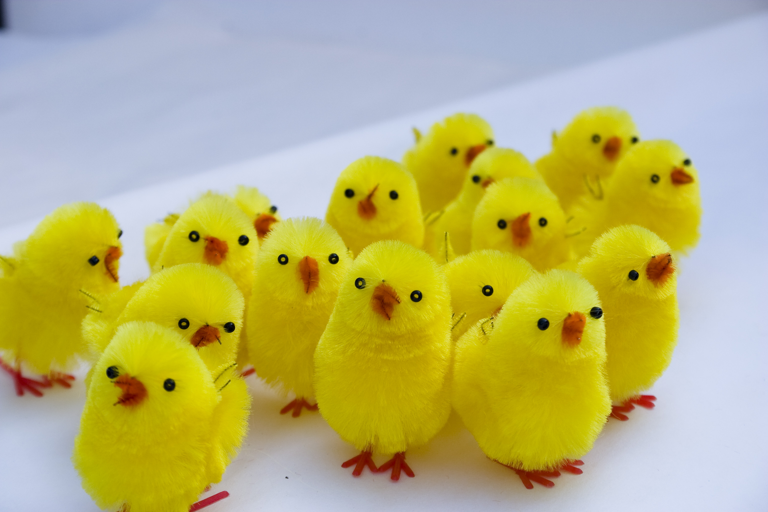
Team "PITT VARIEGATED"
Georgi
developer and project manager
Niki
developer and quality assurance
Mario
developer and graphic designer
Toni
developer and web designer

Slide 7
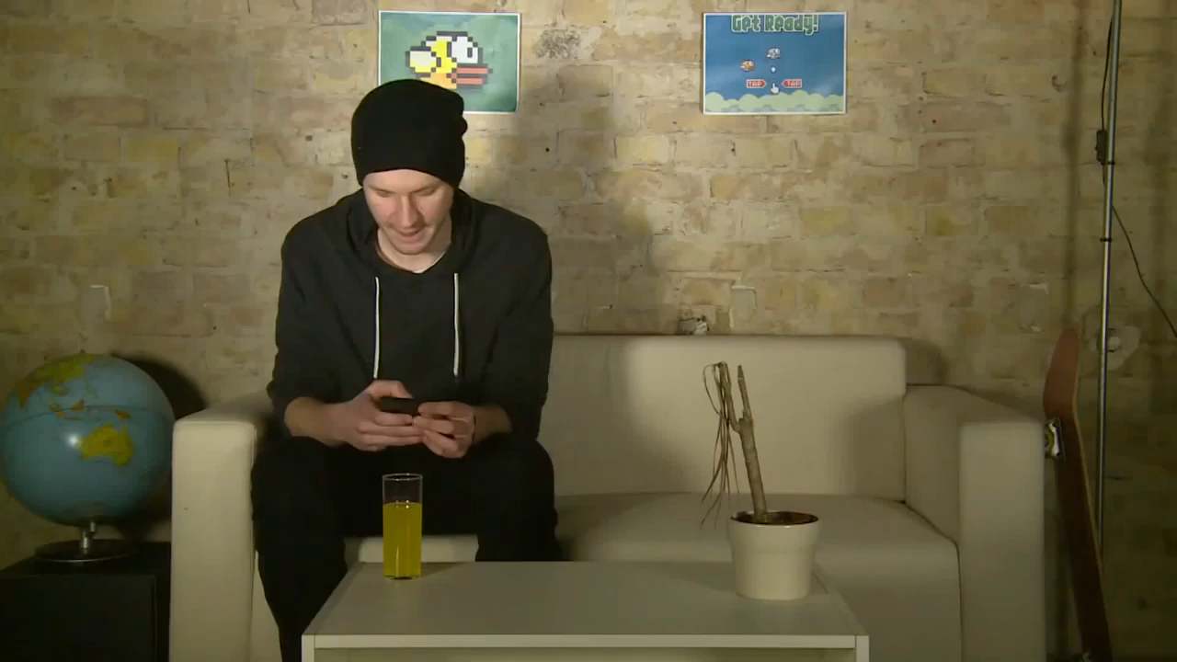
THANK YOU!

